Slide 1

Algorithms and Data Structures 1 CS 0445
Fall 2023
Array-based implementations of the ADT Bag
Sherif Khattab
ksm73@pitt.edu
(Slides are adapted from Dr. Ramirez’s and Dr. Farnan’s CS1501 slides.)

Slide 2
Announcements
Upcoming Deadlines:
Homework 2: Tuesday 9/12 @ 11:59 pm
Lab 1: Friday 9/15 @ 11:59 pm
Programming Assignment 1: Friday 9/29 @ 11:59 pm

Slide 3
But first …
Few more Java review topics
Deep(er) copying of generic types
Exceptions
File I/O

Slide 4
Deeper Copying of Generic Types
import java.lang.reflect.Constructor;
public <T> T copy(T a){
Class<?> c = a.getClass();
T copy = null;
try{
Constructor<?> copyConstructor = c.getConstructor(c);
copy = (T) copyConstructor.newInstance(a);
} catch (Exception e){
copy = a;//fall back to shallow copy if no copy constructor
}
return copy;
}

Slide 5
Exception Basics
Exceptions used when unexpected situations happen at runtime
A method uses an exception to send a signal to the caller
e.g., caller didn’t adhere to method’s preconditions
Method creates and throws an exception object
We say “throws an exception”
Caller may catch or forward the exception
If thrown exception not caught, the program crashes

Slide 6
Exception Checking at Compile Time
Only Checked exceptions are checked by the compiler
Compiler makes sure checked exceptions caught or forwarded
Example of Checked Exceptions in Java Class Library
ClassNotFoundException
FileNotFoundException
IOException
NoSuchMethodException
WriteAbortedException

Slide 7
Runtime Exceptions Not Checked by Compiler
Runtime exceptions not checked by the compiler
Examples in the Java Class Library:
ArithmeticException
NullPointerException
ArrayIndexOutOfBoundsException
StringIndexOutOfBoundsException
IndexOutOfBoundsException
ClassCastException
IllegalArgumentException
IllegalStateException
NoSuchElementException
UnsupportedOperationException

Slide 8
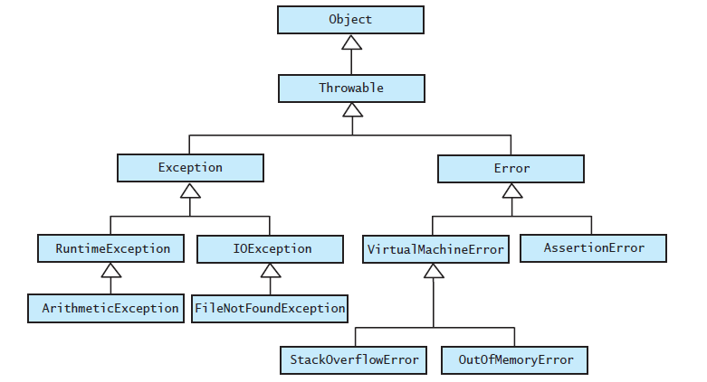
Exceptions are Classes
The hierarchy of some standard exception and error classes
We can define new checked Exception classes by extending Exception for example

Slide 9

Throwing an Exception
A method intentionally throws an exception by executing a throw statement
Usually create an object of the Exception class within the throw statement
called anonymous object
the class of the thrown Exception must be already defined

Slide 10
When to throw an Exception
If you can resolve unusual situation in a reasonable manner
likely can use a decision statement instead of throwing an exception
If several resolutions to abnormal occurrence possible, and you want client to choose
Throw a checked exception
If a programmer makes a coding mistake by using your method incorrectly
Throw a runtime exception

Slide 11
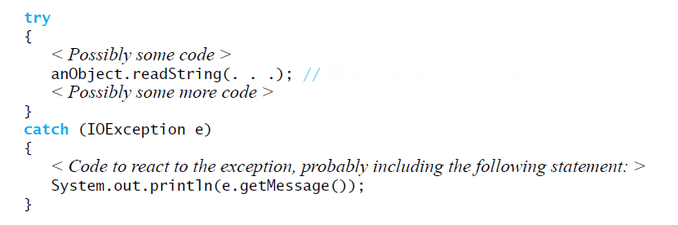
Catching an exception using try-catch
Example: catch an IOException as a result of invoking the method readString
← Might throw an IOException

Slide 12
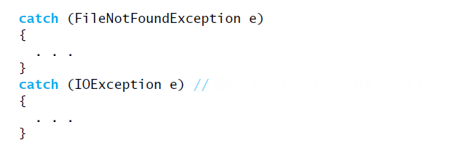
Multiple catch Blocks
Order for catch blocks matters!
Start with most specific exceptions
← Handle all other IOExceptions

Slide 13

Forwarding an Exception
A method that can cause or receive but does not handle an exception must declare it in its header
The throws clause must declare all checked exceptions thrown or received by a method

Slide 14
Writing to a Text File
PrintWriter allows for writing into a text-output stream
e.g., a file
PrintWriter prints formatted representations of Objects
Please always Check the JDK documentation (linked from Canvas) for more details

Slide 15
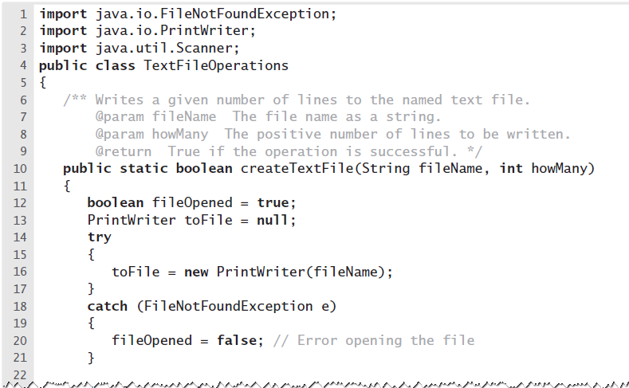
PrintWriter Example

Slide 16
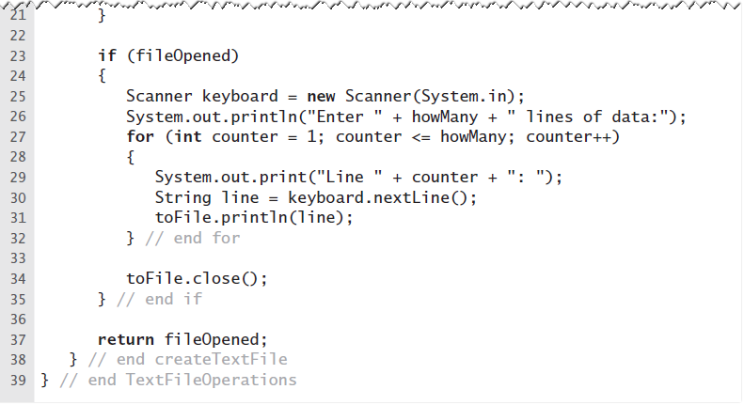
PrintWriter Example
can use print() and println()

Slide 17
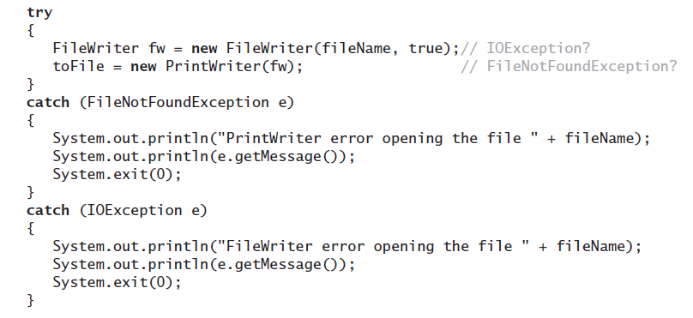
can wrap FileWriter inside PrintWriter
Open a file for appending

Slide 18
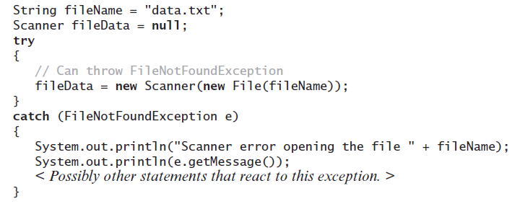
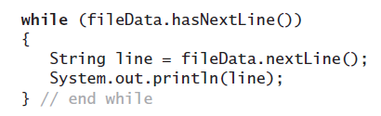
Reading a Text File using Scanner
Opening the text file named data.txt for input

Slide 19
Bag ADT
The ADT Bag
No rule about how many items to put in
No rule about the order of the items
No rule about duplicate items
No rule about what type of items to put in
However, we will make it homogeneous by requiring the items to be the same class or subclass of a specific Java type
Let’s look at the interface
See BagInterface.java

Slide 20
BagInterface.java
Note what is NOT in the interface:
Any specification of the data for the collection
We will leave this to the implementation
The interface specifies the behaviors only
However, the implementation is at least partially implied
Must be some type of collection
Any implementation of the methods
Note that other things are not explicitly in the interface but maybe should be
Ex: What the method should do
Ex: How special cases should be handled
We typically have to handle these via comments

Slide 21
ADT Bag
Ex: public boolean add(T newEntry)
We want to consider specifications from two points of view:
What is the purpose / effect of the operation in the normal case?
What unusual / erroneous situations can occur and how do we handle them?
The first point can be handled via preconditions and postconditions
Preconditions indicate what is assumed to be the state of the ADT prior to the method's execution
Postconditions indicate what is the state of the ADT after the method's execution
From the two we can infer the method's effect

Slide 22
ADT Bag
Ex: for add(newEntry) we might have:
Precondition:
Bag is in a valid state containing N items
Postconditions:
Bag is in a valid state containing N+1 items
newEntry is now contained in the Bag
This is somewhat mathematical, so many ADTs also have operation descriptions explaining the operation in plainer terms
More complex operations may also have more complex conditions
However, pre and postconditions can be very important for verifying correctness of methods

Slide 23
ADT Bag
The second point (abnormal cases) is often trickier to handle
Sometimes the unusual / erroneous circumstances are not obvious
Often they can be handled in more than one way
Ex: for add(newEntry) we might have
Bag is not valid to begin with due to a previous error
newEntry is not a valid object
Assuming we detect the problem, we could handle it by
Doing a "no op"
Returning a false boolean value
Throwing an exception
We need to make these clear to the user of the ADT so they know what to expect

Slide 24
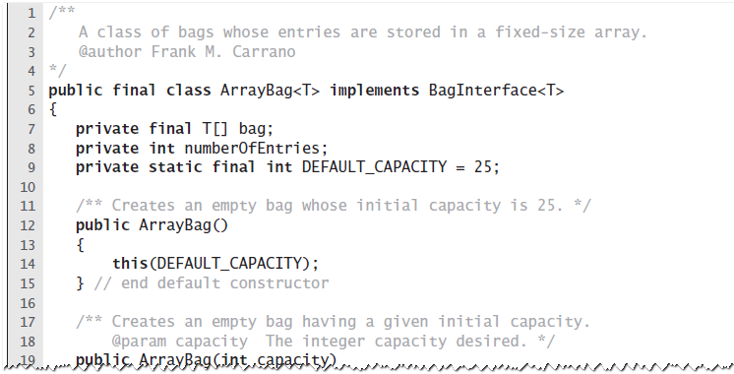
First Implementation of ADT Bag: Fixed-Size Array
An outline of the class ArrayBag.java

Slide 25
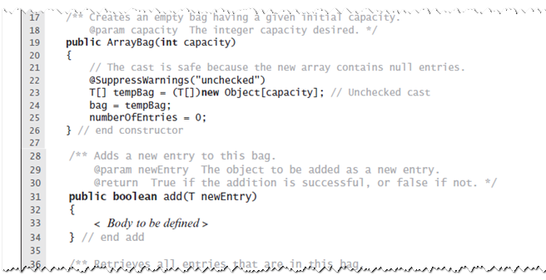
Fixed-Size Array
A Constructor for ArrayBag

Slide 26
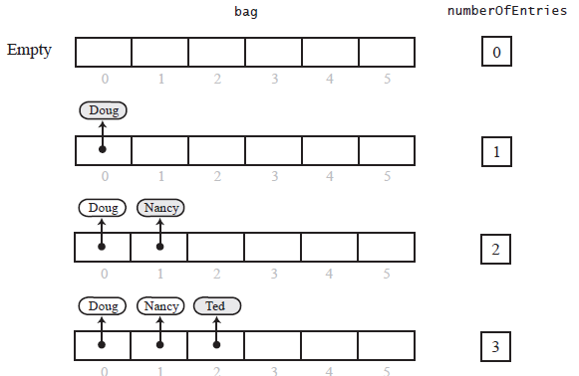
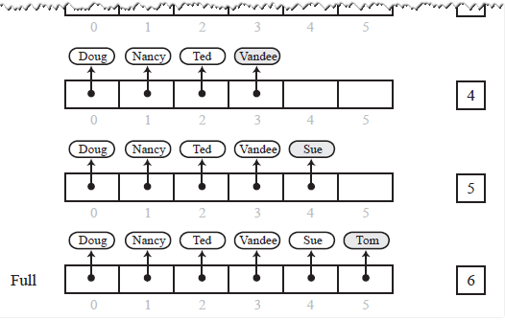
Fixed-Size Array
Adding entries to an array that represents a bag, whose capacity is six, until it becomes full

Slide 27
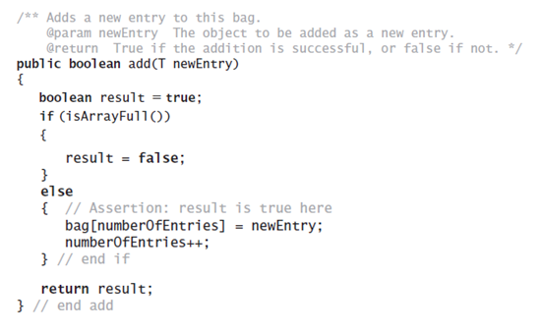
Fixed-Size Array
Method add

Slide 28
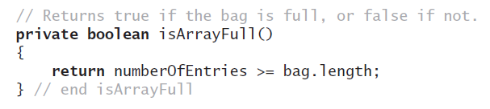
Fixed-Size Array
Method isArrayFull

Slide 29
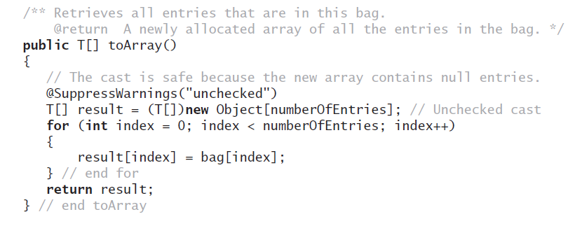
Fixed-Size Array
Method toArray

Slide 30
A note on toArray()
Assume ArrayBag<String> bagOfStrings = new ArrayBag<>();
Since toArray is defined to return T[], compiler will convert it to
Object[] toArray()
This is called type erasure
Compiler will also insert type casting parentheses in the following statement:
String[] strings = bagOfStrings.toArray();
So, it becomes:
String[] strings = (String[]) bagOfStrings.toArray();
Since it is not legal to cast Object[] to String[], this will throw a ClassCastException at runtime
Solution:
Object[] strings = bagOfStrings.toArray();
for (Object o : strings) {
String s = (String) o;
}

